Slide 1
Formative Assessment with Plickers!
Heather Gabel
Math Department Chair
Harrison High School

Slide 2
Let’s try a few questions . . .

Slide 3
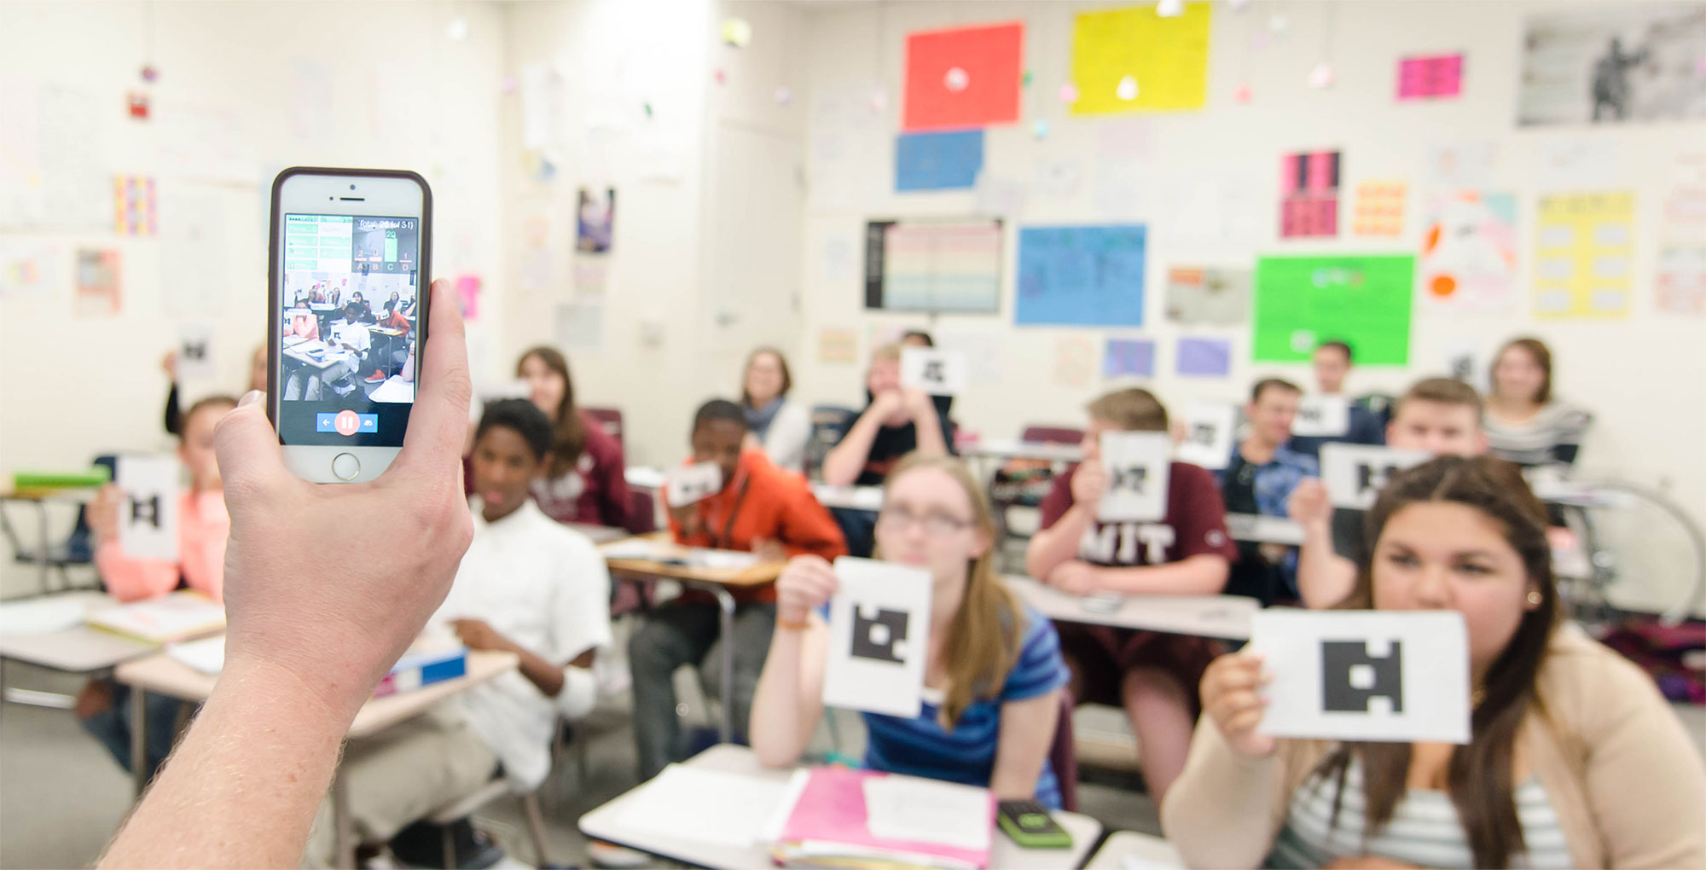
What is Plickers?
Plickers is a powerfully simple tool that lets teachers collect real-time formative assessment data without the need for student devices
In other words, Sheets of paper that work like a set of classroom clickers with your smartphone.

Slide 4
What devices can operate Plickers?

Slide 5
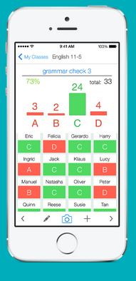
Why should I use Plickers?
Tailor instruction with instant feedback
Use Plickers for quick checks for understanding to know whether your students are understanding big concepts and mastering key skills.

Slide 6
Why should I use Plickers?
Engage ALL students in critical thinking
Give all students the chance to participate and engage in learning without feeling self-conscious.

Slide 7
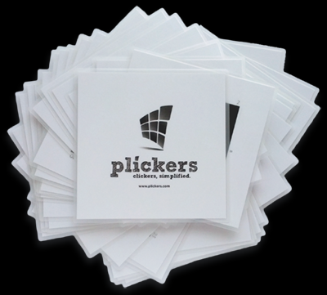
Why should I use Plickers?
Focus more on teaching, less on set-up
No waiting for students to log-in on a computer or even open the right app. Plickers integrates seamlessly into the way you already teach.

Slide 8
Getting Started
Downloading the Plickers App
In order to scan students' responses, you must have the Plickers mobile app installed.
Only the teacher needs the Plickers app on a mobile device; students don't need to download anything!
For the iPad, you may need to filter by "iPhone only" and then search for Plickers in order to show it in the App Store.

Slide 9
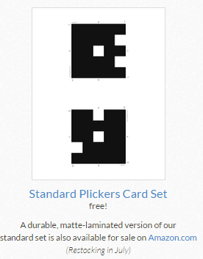
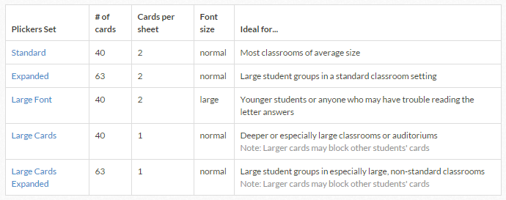
Getting Started
2. Printing Cards
Print the Standard Set or checkout other options on our cards page
We recommend printing on cardstock so your cards more durable. If you choose to also laminate your cards, a matte laminate helps prevent glare that may make scanning less efficient.

Slide 10
FAQ on Plickers Cards
Q: Can I use the same card set for multiple classes?
A: Yes, you would simply use the same set (or print out multiples of the same set) of cards across the classes. Plickers will let you assign cards to students in each class, so you might have, for example, six #1 cards assigned to six different students. Since they're not in the same class period at the same time, the #1 card will only be read as one individual student -- the one associated with that particular class period the poll question is planned for.

Slide 11
FAQ on Plickers Cards
Q: How do you recommend printing these cards?
A: To ensure that the Plickers app reads the cards quickly and easily, we'd recommend printing on white paper or cardstock. You can also laminate the cards to make them more durable, but try to avoid laminating the cards if you do not have a matte laminating option; the typical glossy lamination creates glare on the cards that can make them difficult for the app to read as quickly. Another way you can make your cards more durable is to have students paste them onto the inside cover of a notebook; this way they always have the cards for class (well, at least they should!) When doing so, you may want to encourage students to paste these in with a random orientation (not all with A at the top) so that when they're holding up their answers, they can still have anonymous answers.

Slide 12
FAQ on Plickers Cards
Q: Why does the standard set of cards feature smaller font for the letter answers? Why aren't the answers written on the back of the cards?
A: We want you to have the most accurate data possible about what your students do and don't know, and we want your students to feel comfortable answering honestly. The small print of the answers and the unique shapes on each Plickers card help protect students' privacy so they can answer your questions honestly without worrying about what their peers think of their answer. If you still think your class would benefit from a larger print version, it's available above!

Slide 13
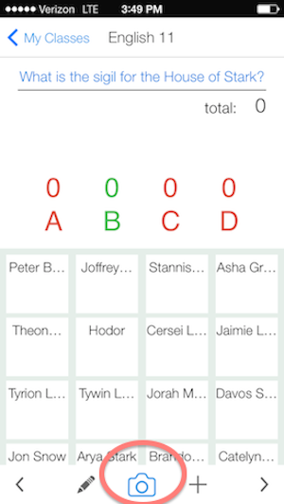
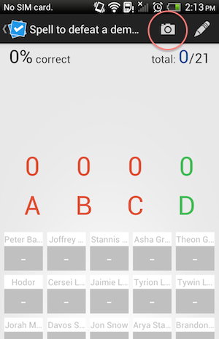
Scanning Cards
Before you scan, make sure that you've created a question! From the question screen, select the camera icon at the bottom (iOS) or at the top (Android)

Slide 14
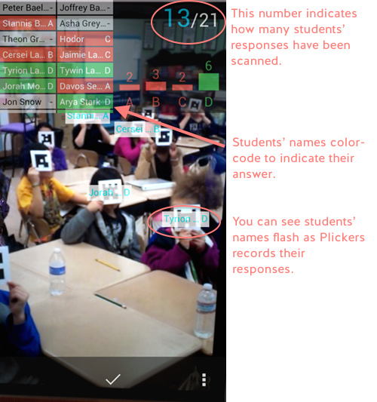
Scanning Cards
Hold your mobile device vertically in portrait mode to scan your students' cards.
Notice that Plickers will display how many students' responses you've captured and which students you do not have data for. Use this information to rescan dfferent areas of the class until you've gotten all students' responses!
**Tip: Encourage students to hold their cards by the edges so their fingers don't accidently cover the Plickers code. A distance of 3-15 feet away is best

Slide 15
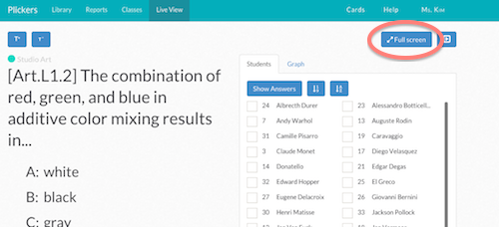
Live View
The Live View tab on the website enables you to display your question and answer choices to your students and share their real-time responses as your scan the class.

Slide 16
Using Live View
Live View will update with checkmarks to indicate which students' answers have been recorded. This is a nice visual cue to help students know when they can put their cards down.
**Live View also has a few other views that may be helpful in your teaching. The Graph view allows you to review the class's results. Adding "Show answer" to either the individual student response panel or the graph view will reveal the correct/incorrect answers.

Slide 17
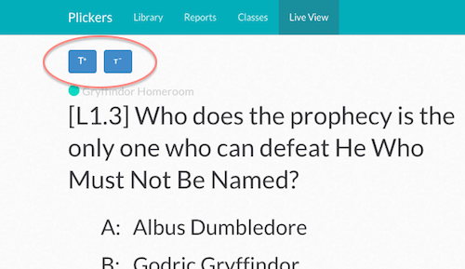
Using Live View
To increase or decrease the text size of your Live View display, click the text resizing buttons above the class name:

Slide 18
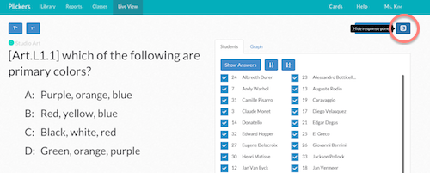
Using Live View
To hide the student response panel on Live View so that only your question and answer choices are showing, click the flex-panel button next to the full-screen button:

Slide 19
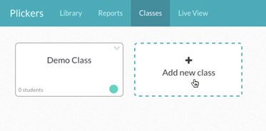
Creating Classes and Students
Go to Plickers.com and sign-in with the same user ID that you use for the mobile app.
Select [+ Add a new class]
Enter your class name and fill in the other relevant information and save. The colored dot will color-code all questions and reports related to this class.
Type in student names and press the "enter" key after. Plickers will automatically assign each student a unique card number so you can review individual student data for your questions.

Slide 20
Creating Questions and Polls
Adding Questions on the Web
From your Library, type in the question body in the top bar. Once you start typing, the question entry box should expand to reveal your answer choices.
You can set the type of question to True/False or you can delete unneeded answer choices by clicking on the X next to the answers to delete.
Set the correct answer if there is one by simply clicking the checkbox for which answer(s) are correct. Note that you also can scan Plickers cards without setting a correct answer; this may come in handy for student surveys or for questions with more than one correct answer.
Click [Save] to save the question.
You'll then be prompted to plan your question for any of your classes. Check as many classes as you'd like; you can even select the same class multiple times. Planning your question for a class will enable you to immediately use it from your mobile app's "Planned" questions list.

Slide 21
Creating Questions and Polls

Slide 23
Creating Questions and Polls
Adding Questions in the Mobile App
From the home screen with the list of classes, select the class you'd like to create a question for. Tap the [+] button at the top of the screen to add a new question.
Then select "Create" to make a new question
You can either type in your full question (ex: "Which of the following sentences contains a comma splice?") or just label it with a shorthand label (ex: Q1 or Grammar Check 1). Set the correct answer if there is one by simply tapping on one of the lettered answer choices. You can select multiple correct answers if you'd like. Note that you also can scan Plickers cards without setting a correct answer; this may come in handy for student surveys or for questions with more than one correct answer.
You don't need to add answer choice text to go ahead and start using this question, but if you'd like to fill in the full answer field text, then toggle the "Advanced" options on to reveal the answer choice text fields
Tap [Done] to save the question.

Slide 24
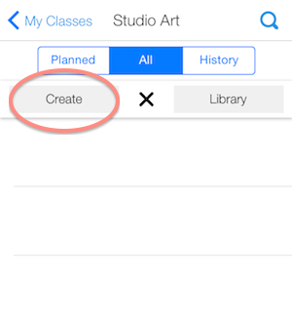
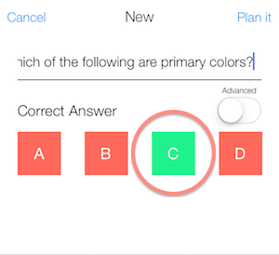
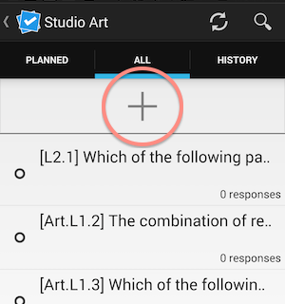
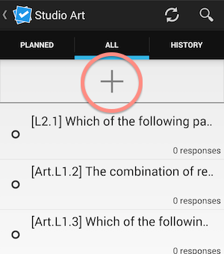
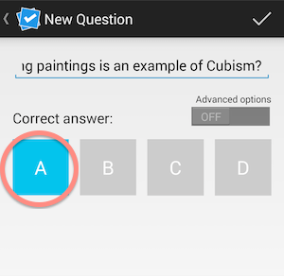
Creating Questions and Polls

Slide 25
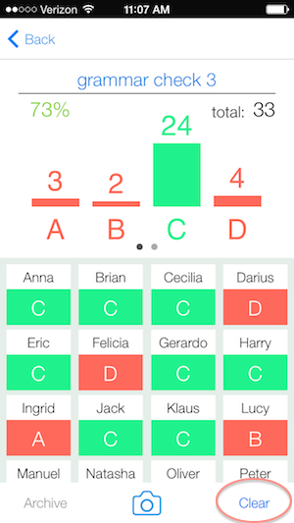
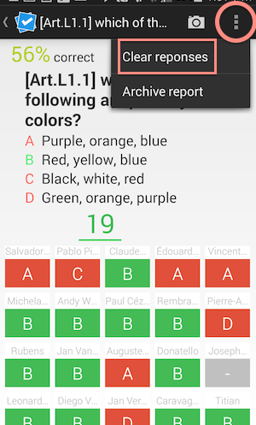
Clearing Responses on the Mobile App
If you'd like to reuse a question and don't mind losing the previously collected responses, you can clear the responses from your mobile app.
Click on a completed poll from your History list on your mobile app
Then select "Clear" to delete all of the previously collected student responses

Slide 26
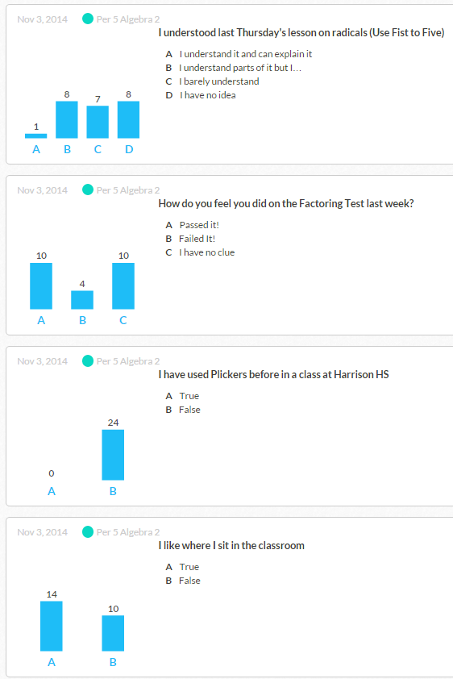
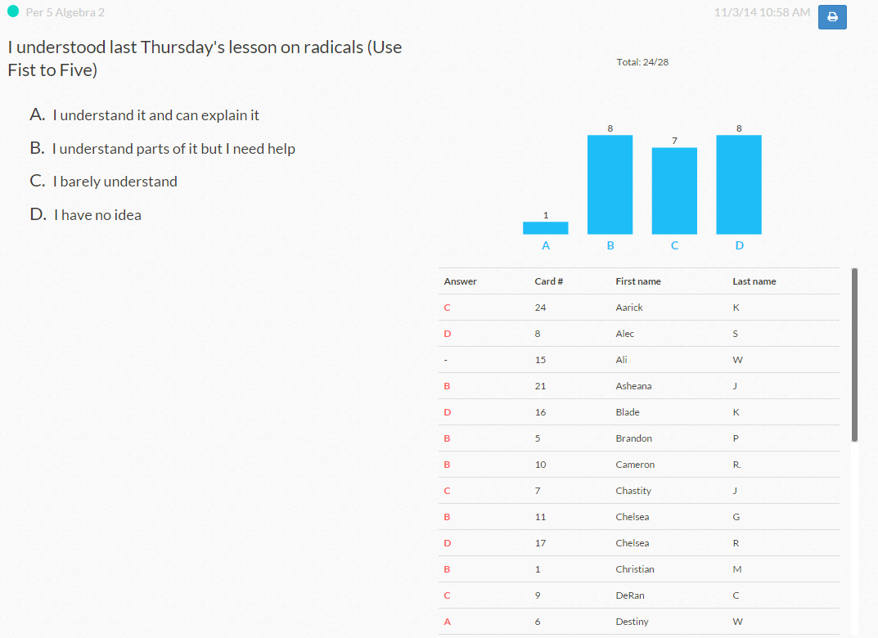
Reports
At this time, there is only a single completed poll report; individual student reports and spreadsheet export are both popular feature requests we look forward to implementing in the future!

Slide 28
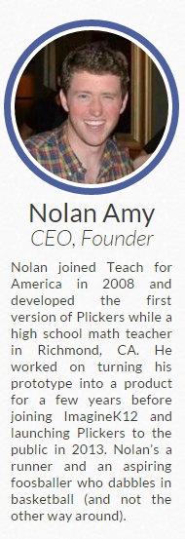
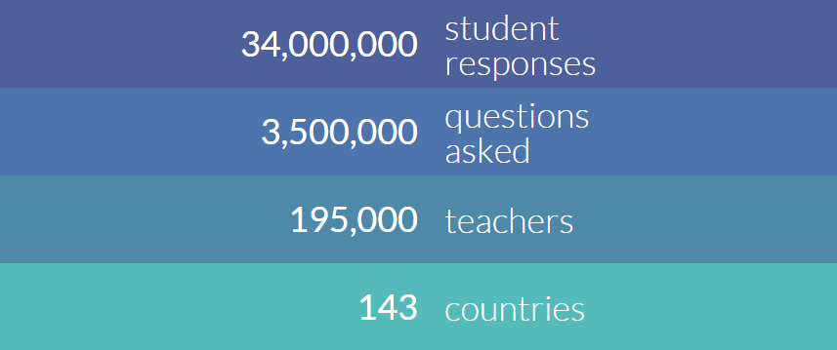

Slide 29
ACTION!
Demo Class – 3 Questions
Share how you would use Plickers in your classroom
Is there any setting you cannot use these in?

